Slide 1

PHASE 3
Then new road to inventory management

Slide 2
01
Quality
02
Entity Relationship/DFD
03
Use Case Document
04
GUI updates
How quality is managed throughout the lifecycle
Structure and Flow
Tie business needs into system
What we have learned/changed
2

Slide 3

01-Quality
Quality Management
-Product quality for Dynasty Cars’ project is defined by the company’s current standards and criteria for its inventory management system.
-The project team will work with Dynasty Cars to define and document all organizational and project specific quality standards for both product and processes.
-All quality documentation will become part of Dynasty Cars daily operations upon the successful completion of the project.
01
3

Slide 4
Quality Metrics
Metrics will be established and used to measure quality throughout the project life cycle for the product and processes.
Metric | Criterion or Formula | Frequency | Report
Schedule | Must fit the needs of all team members | Twice a week for duration of project | QMR Phase 4
Resources | 4 team members | 2 times a week | QMR Phase 4
Test Coverage Ratio | A - Total lines of code in the program B - lines of code being executed Formula: (B divided by A) times 100 | Phase 3 and Phase 4 | 89.2% Actual at Phase 3 Review again at Phase 4
Pull Request Quality | If approved by all team members, merged with master branch | Review Git Hub Daily | Generated at every request in GitHub
Bugs | This will depend on severity of bug | Daily | As situations occur
Application Crash Ratio | Optimal would be 0 | Each Phase | As situations occur

Slide 5
Quality control
The project team will perform assessments at planned intervals throughout the project to ensure all processes are being correctly implemented and executed
Quality Assurance
Process Action | Guidelines | Process Phase | Assessment Interval
Efficiency | Each developer reviews and comments on all code being pushed before final review. Program compiles without errors. | Phase 2,3,4 | End of each phase
Maintainability | System can receive and push changes in data without crashing or experiencing visual glitches. | Phase 3,4 | End of each phase
Product | Physical/Performance Standards | Quality Assessment Activities | Assessment Intervals
Functionality | Functions of software must be appropriate and compliant with required laws and guidelines. Data is handled securely. | Group Testing of program | End of each Phase
Reliability | Reach full operation without failure | Group Testing of program | End of each Phase
Usability | Software functions are easily understood | Group Testing of program | End of each Phase

Slide 6
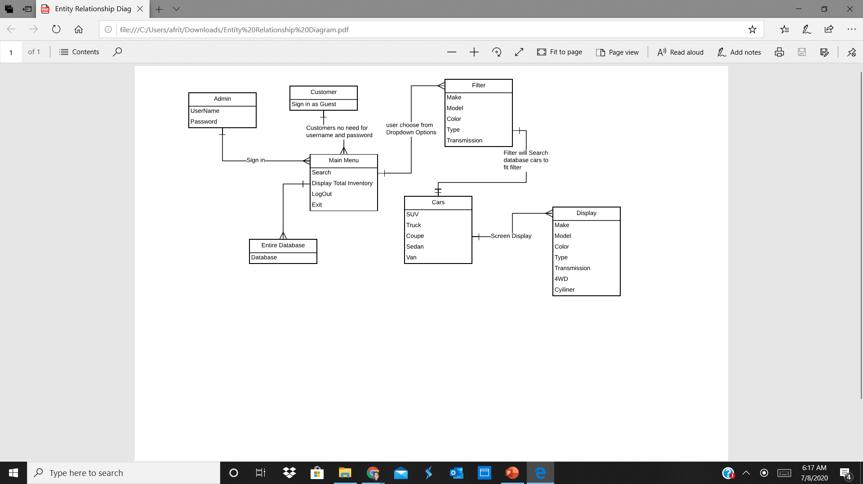
02
Entity Relationship/DFD
-The Program and how
Fields interact
-And why we used these Fields
6

Slide 7
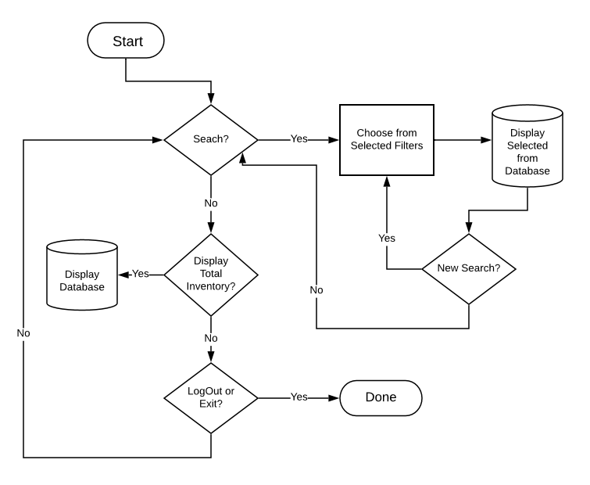
Flow-chart
Start to Finish of the Users Pathway through the System
7

Slide 8

03- Use Case Document
Dynasty Cars Inventory Systems
The Use Case Document is a business document that provides a story of how our inventory system will be used to allow guests and admins to search for vehicles on Dynasty Cars’ lot.
This document will include a detailed step-by-step description of how the system will be used by its actors as well as details on actors, preconditions, post-conditions, flow and alternative flows, exceptions, and requirements.

Slide 9
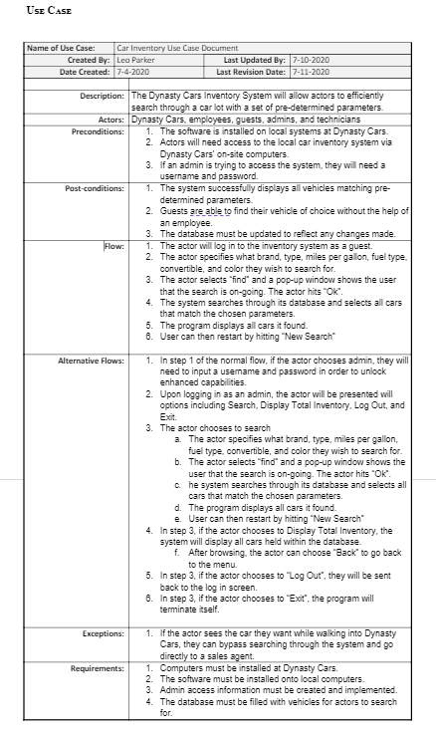
Use Case Flows
Flow:
1. The actor will log in to the inventory system as a guest.
2. The actor specifies what brand, type, miles per gallon, fuel type, convertible, and color they wish to search for.
3. The actor selects “find” and a pop-up window shows the user that the search is on-going. The actor hits “Ok”.
4. The system searches through its database and selects all cars that match the chosen parameters.
5. The program displays all cars it found.
6. User can then restart by hitting “New Search”
Alternative Flow:
1. In step 1 of the normal flow, if the actor chooses admin, they will need to input a username and password in order to unlock enhanced capabilities.
2. Upon logging in as an admin, the actor will be presented will options including Search, Display Total Inventory, Log Out, and Exit.
3. The actor chooses to search
4. In step 3, if the actor chooses to Display Total Inventory, the system will display all cars held within the database.
5. In step 3, if the actor chooses to “Log Out”, they will be sent back to the log in screen.
6. In step 3, if the actor chooses to “Exit”, the program will terminate itself.

Slide 10

04
GUI Updates /changes
10

Slide 11
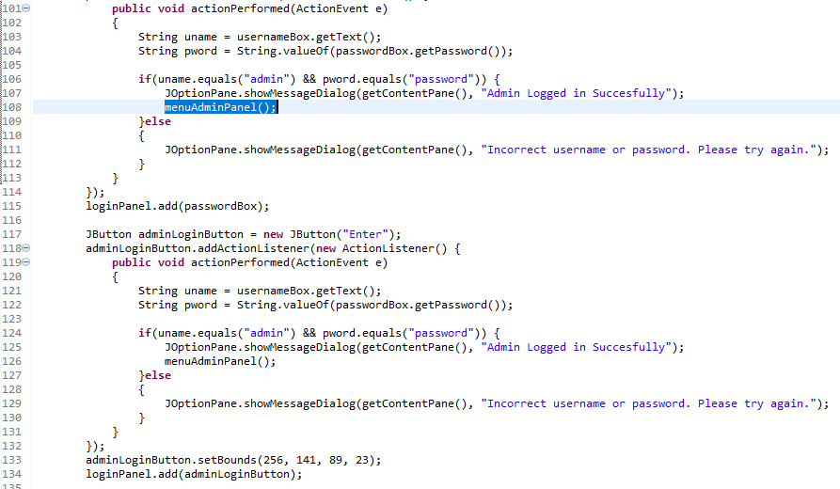
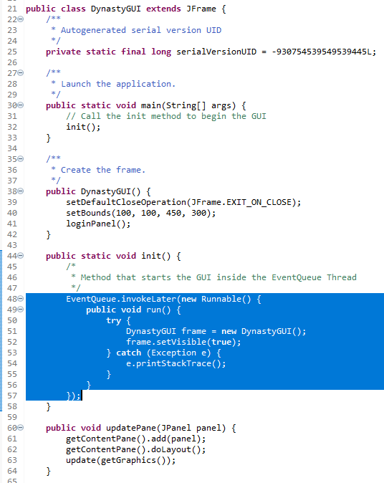
Increasing GUI Efficiency
Tools:
EventQueue.
.SetVisible
UpdatePane()
Why:
This further improves program efficiency and reduces memory usage as it does not have to write a brand-new frame every time the user navigates to a new panel.
How:
The frame is rewritten every time a new function is called rather than being destroyed.

Slide 12

THANKS!

